Slide 1
Digital Portfolio
STUDENT NAME: MOHITH M
REGISTER NO AND NMID: 222407871/autunm1455ds242711
DEPARTMENT: BSC –COMPUTER SCIENCE WITH DATA SCIENCE
COLLEGE: TAGORE COLLEGE OF ARTS AND SCIENCE

Slide 2
PROJECT TITLE
Portfolio of Mohith

Slide 3


AGENDA
Problem Statement
Project Overview
End Users
Tools and Technologies
Portfolio design and Layout
Features and Functionality
Results and Screenshots
Conclusion
Github Link
3/21/2024 Annual Review

Slide 4

PROBLEM STATEMENT
This portfolio was built to highlight my skills, share my projects, and establish my presence as an aspiring developer and data science enthusiast.

Slide 5

PROJECT OVERVIEW
This portfolio website showcases Mohith’s skills, projects, and contact details as a 2nd-year BSc Computer Science with Data Science student. It features interactive skill and project cards that reveal descriptions on click, a clean dark-themed design with glowing effects, and a responsive layout for all devices. Built with HTML, CSS, and JavaScript, the site highlights Mohith’s technical abilities and academic background in an engaging and professional way.

Slide 6

WHO ARE THE END USERS?
Employers and recruiters
Fellow students and peers
Professors and academic advisors
Potential clients and collaborators
Anyone interested in Mohith’s skills and projects

Slide 7

TOOLS AND TECHNIQUES
HTML, CSS, JavaScript
Responsive design with Flexbox
Dark theme with glow effects
Interactive card toggles

Slide 8
POTFOLIO DESIGN AND LAYOUT
The portfolio features a clean, dark-themed layout with glowing cyan accents. It uses a centered, single-column design with sections for About, Skills, Courses, Projects, and Contact. Interactive cards display detailed info on click, arranged with flexible, responsive layouts for smooth viewing on all devices.
8

Slide 9
FEATURES AND FUNCTIONALITY
Interactive Skill & Project Cards
Responsive Design
Glow Effects.
Smooth Navigation
Contact Links
Clean Layout

Slide 10
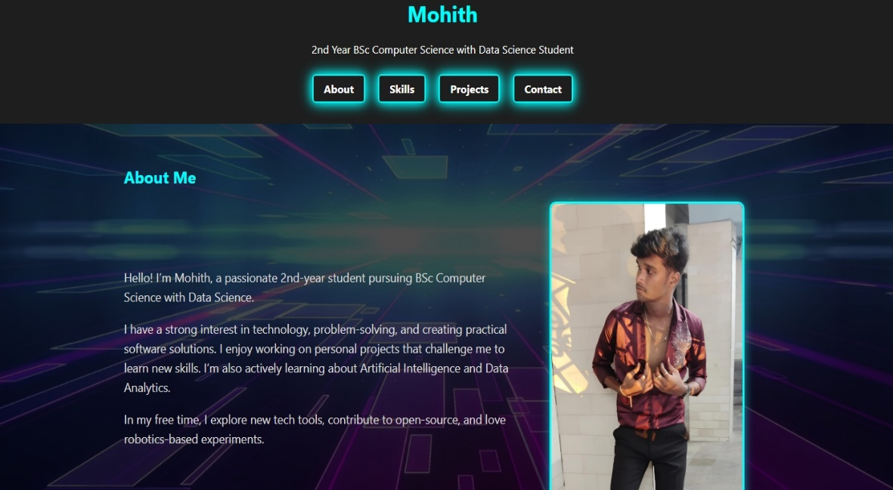
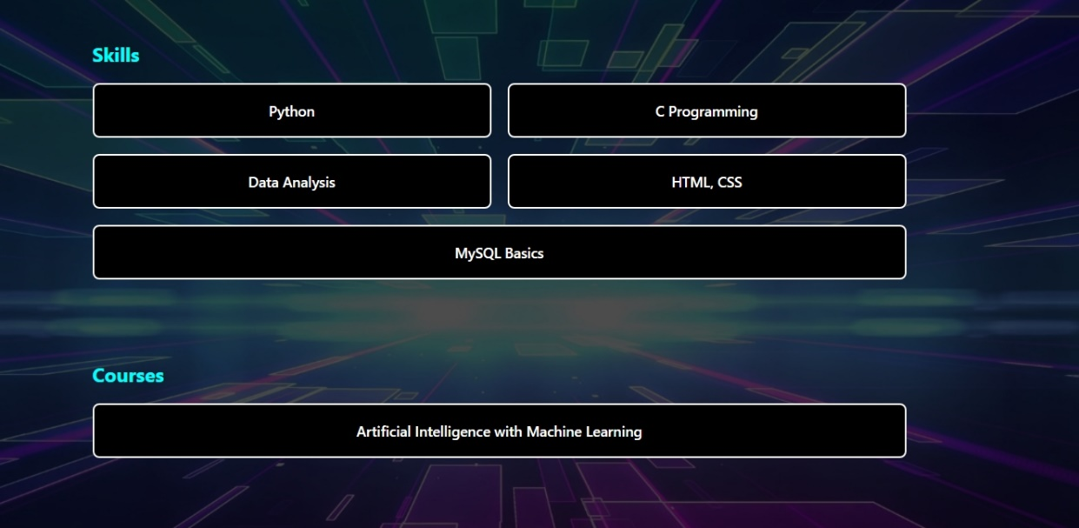

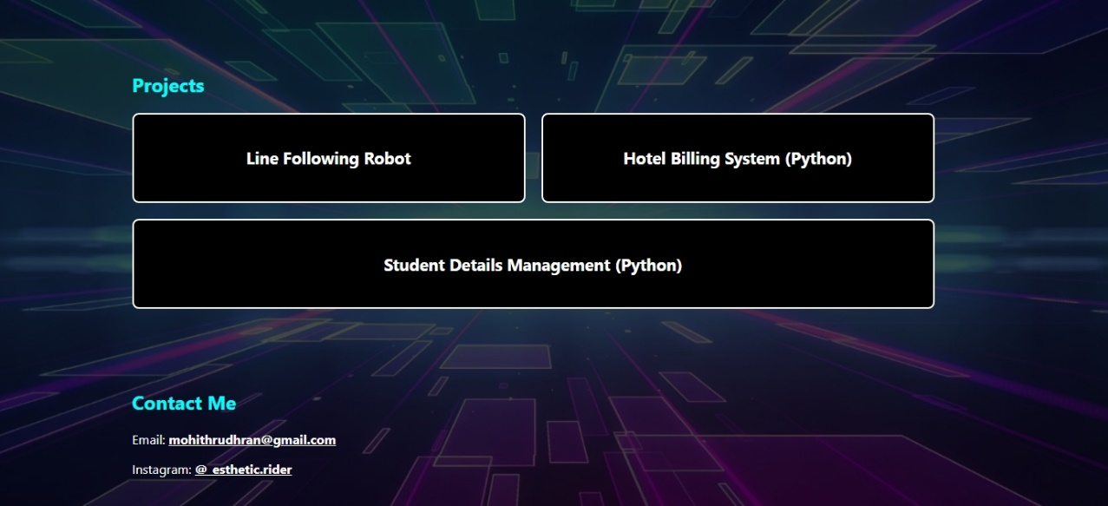
RESULTS AND SCREENSHOTS
3/21/2024 Annual Review
10

Slide 11
CONCLUSION
This portfolio effectively showcases Mohith’s skills, projects, and academic journey in a modern, interactive, and user-friendly way. It serves as a professional platform to connect with employers, peers, and collaborators, highlighting technical expertise and passion for computer science and data science. The clean design and responsive layout ensure a great experience across all devices.
11

